Slide 1
AI BASED BRAIN CONTROLLED WHEEL CHAIR
SUPERVISOR: DR OMAIR INAM
CO-SUPERVISOR: DR MEHMOOD QURESHI
GROUP MEMBERS: MEHAR DIL [FA18-BCE-031]
HUZAIFA MAQSOOD[FA18-BCE-025]
HIRA SHAHID[FA18-BCE-024]

Slide 2
Outline:
Problem Statement
Objective
Key Contributions
Overview
Methodology
Results
Summary
Project Timeline
Bibliography

Slide 3
Problem Statement:
“ There is no cure or proper treatment for Locked-In Syndrome, therefore LIS patients always rely on external assistance. LIS Patients are dependent on nutritional and physical therapies to live a better and healthy life”

Slide 4
Objective:
“Designing reliable and efficient Artificial Intelligence (AI) based Brain Controlled Wheelchair for Locked-In Syndrome Patients to improve their mobility.”

Slide 5
Key Contributions:
Jaw Movements Detection
AI based Signal Classification
EEG Headset integration with Arduino UNO
Wheelchair Model

Slide 6
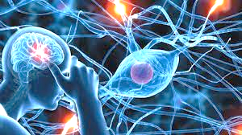
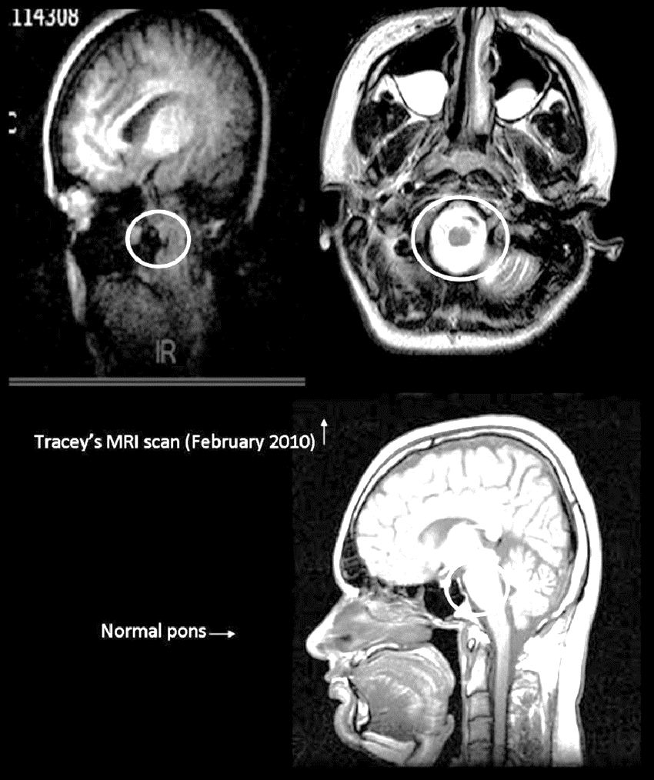
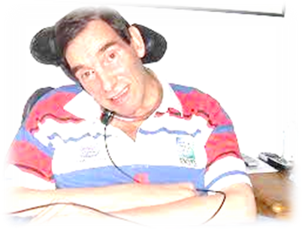
What is LIS? [1]
Locked-In Syndrome
Serious Neurological Disorder
Causes:
Damage Pons
Tumors
Amyotrophic lateral Sclerosis (ALS)
LIS Patients: [1][4]
Survival expectance up to 5-10 years
Possess Cognitive Abilities
Lack of Voluntary Movement
Eyes ,Jaw Movement , posses few Organ’s Sensation
Damage Pons
Neurological Disorder [2]
Normal Pons
Tracery MRI Results [3]
Tony Nicklinson [4]

Slide 7
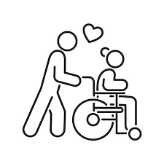





LIS Treatments:
No Cure
or
Treatment
Support
Therapy
Physical
Therapy
Nutritional support
Comfort
Care
Prevention of
Respiratory
Complications

Slide 8

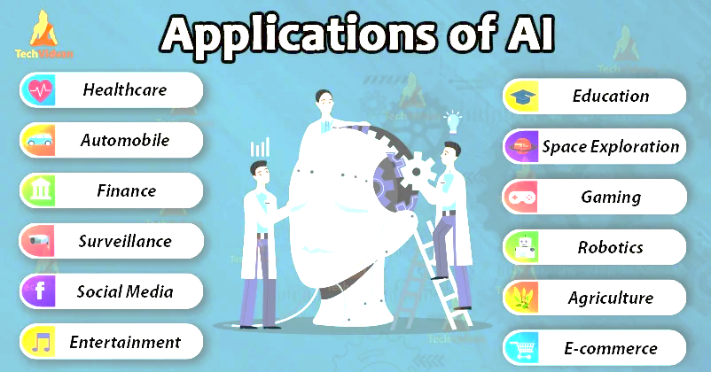
What is Artificial Intelligence?
Capability of thinking
Acting rationally and humanely
Machine Learning is subset of AI
Uses:
Optimizing the search within data
Logic-chains for if-then reasoning
Pattern-detection
Probabilistic models for predicting future outcomes

Slide 9
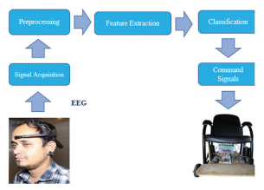
Brain-Controlled Wheelchair for Disabled [5]:
Attention level and Eye blink Encounter for wheelchair movement using EEG Headset.
Working Principle:
Fast Fourier Transform (FFT) analysis
Hardware:
Neurosky MindWave EEG headset
Arduino
WheelChair Model
Limitation:
No AI based algorithm is implemented
Flow Chart Block Diagram of Brain Controlled Wheelchair

Slide 10
Related Work:
EEG-Based Brain-Controlled Wheelchair with Four Different Stimuli Frequencies(2016): [6]
It used the adaptive-network based fuzzy inference system algorithm to control electronic wheelchair movement.
Mind wave wheelchair system(2021): [7]
They used Electroencephalography (EEG) signal manipulation with the Brain-Computer Interface (BCI) which is an emerging technology designed to convert brainwave to real action.

Slide 11
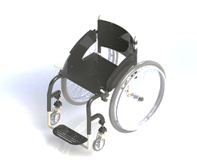
Proposed Methodology:
Working Diagram
B
Signal
Processing
Input
Hardware Module
Brainlink Mindwave
EEG Headset
Machine
Learning
Output
Software Module
Wheelchair
Model
Data Acquisition
Module
Mechanical /
Electrical
Module

Slide 12
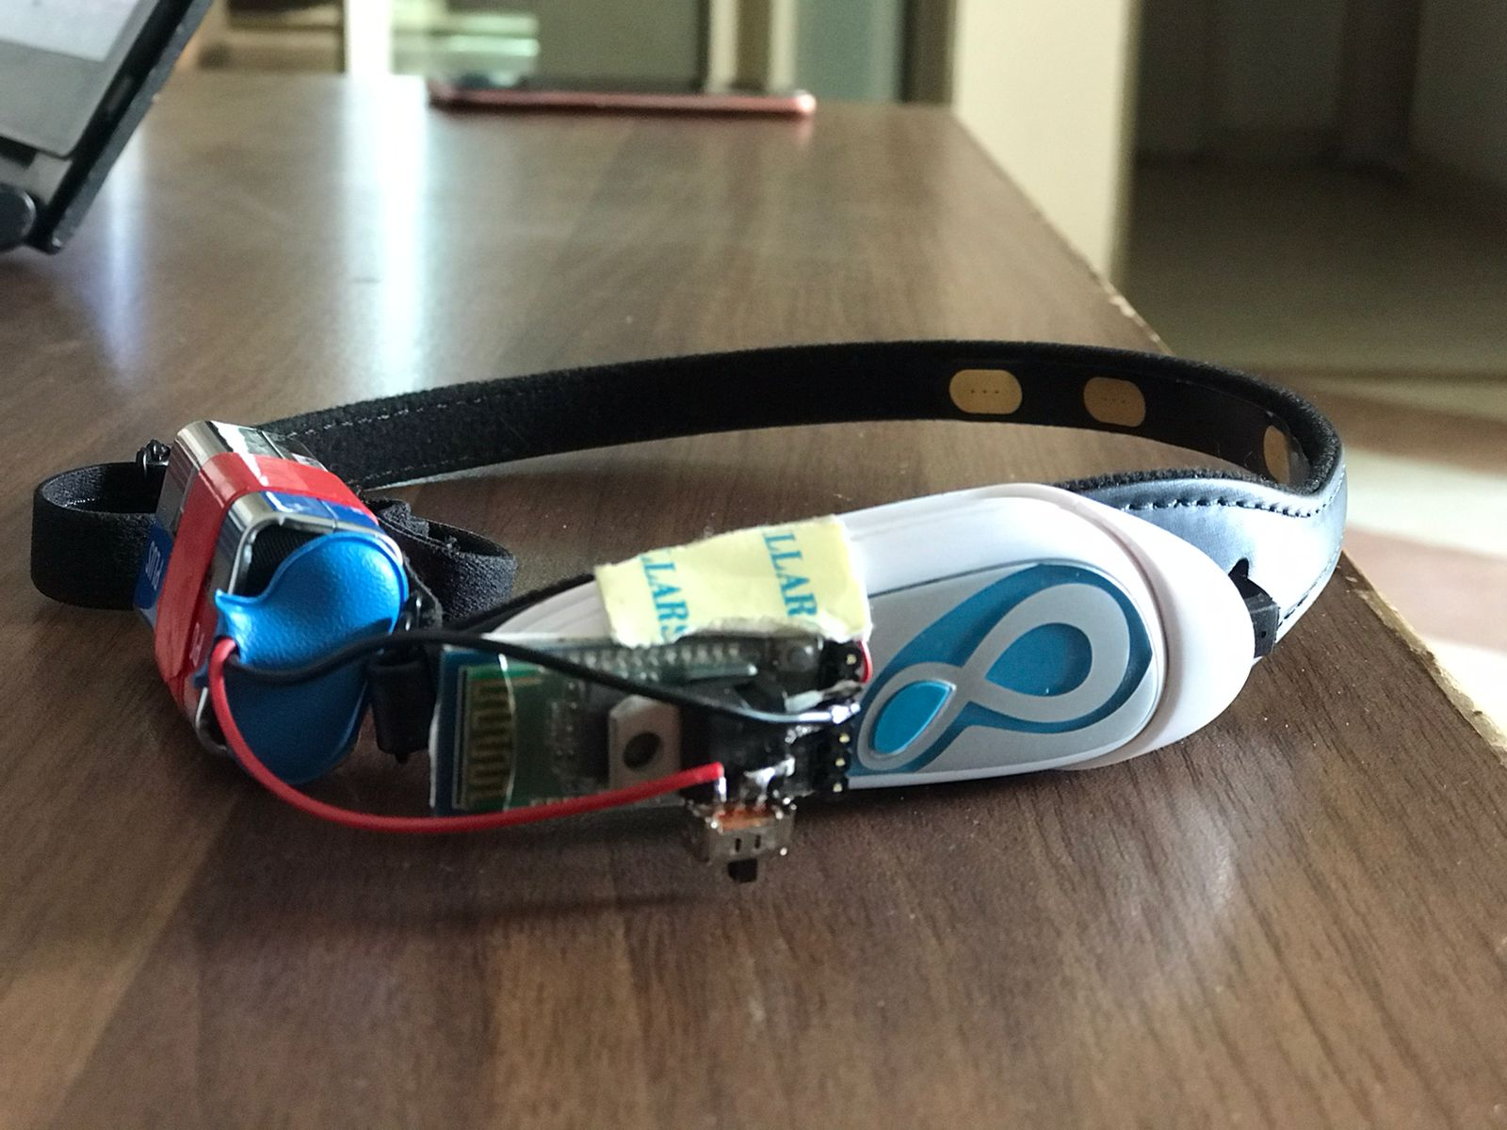
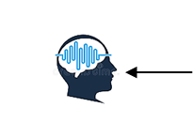
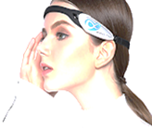
Data Acquisition (1/2)
Brainlink Mindwave EEG Headset:
Brainlink Lite EEG Dry Electrode Headband Mind Control Brainwave Feedback
Connect Via: Bluetooth
Baud Rate: 57600
Transmission range: 10m
Data transmission: UART
Three Dry electrodes
Brain’s Electrical
Activity Detection

Slide 13
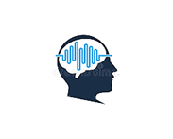


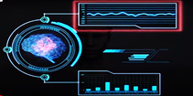
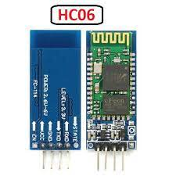
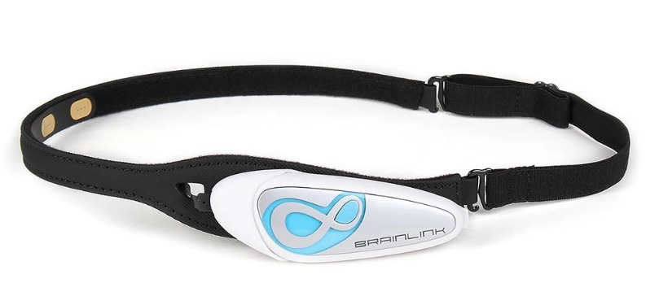
Data Acquisition (2/2)
Detection of Jaw Movement
Alpha Waves (8-12Hz)
Beta Waves (13-20Hz)
Gamma Waves (20-200Hz)
Serial Communication between headset
and Bluetooth.
UART Communication Protocol
Data Acquisition Module
Master
Slave
Serial Communication

Slide 14

Signal Processing
Waveforms: [8]
Alpha Waves: Routine Motor Activities
Beta Waves: Attention Problem Solving
Gamma Waves: Intense Mental Thinking
Butterworth Band Pass Filter: [9]
Bandpass filter the signal between 1-13Hz
Notch Filter: [10]
Band stop filter.
Filter the signal at 13Hz
Filters
Random Forest
Butterworth
Bandpass Filter
Notch Filter
Alpha waves
Machine
Learning
Hardware
Signal Processing Module

Slide 15
Machine Learning
Artificial Models:
Random Forest Classifier:
Machine Learning Algorithm
Performs Regression tasks
Performs Classification tasks
This model gives predicted output

Slide 16
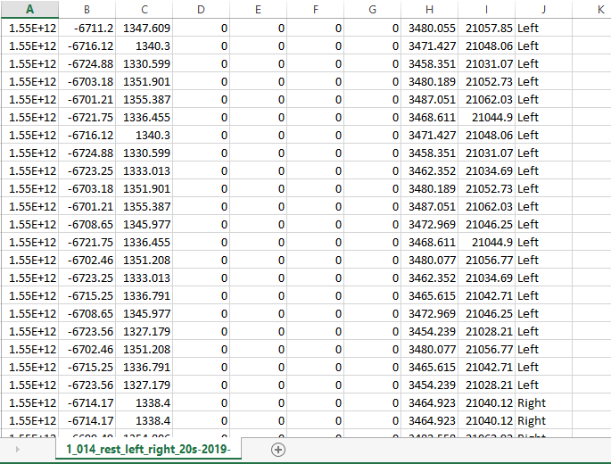
Data Sets [11] [12]
Source:
McGill University Faculties of Arts, Science
and Engineering, University of Montreal,
Canada
Marley Xiong , Jenisha Patel and Raffi Hotter.
35 different Healthy Person
Sample Rate = 255Hz
Used Keras API for training
One of the Data Set

Slide 17
Model Structure
30 inputs.
Outputs = 2
Four functions :
Left, Right, Forward and Rest.
3 Hidden Layers
Hidden Layers
x1
x2
Input layer
Output Layer
xn
Sigmoid
function
2
outputs
ReLU
function
ReLU
function
10
neurons
30 inputs
20
neurons

Slide 18
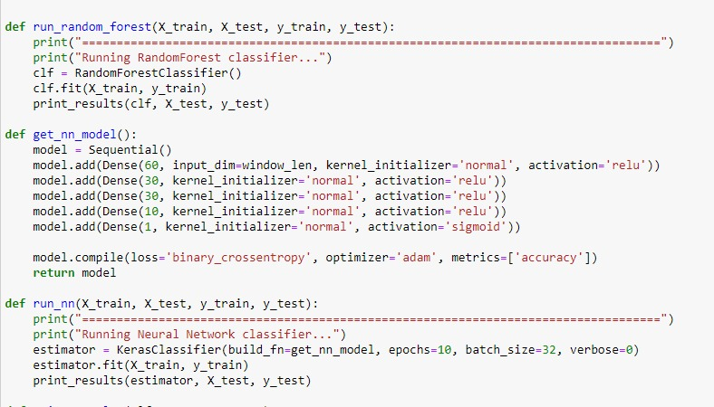
Model
Jupyter Notebook
Used Dense Model
Random Forest Classifier
Epochs = 10
Adam Optimizer
Activation Functions:
ReLU
Sigmoid
Training a Model

Slide 19
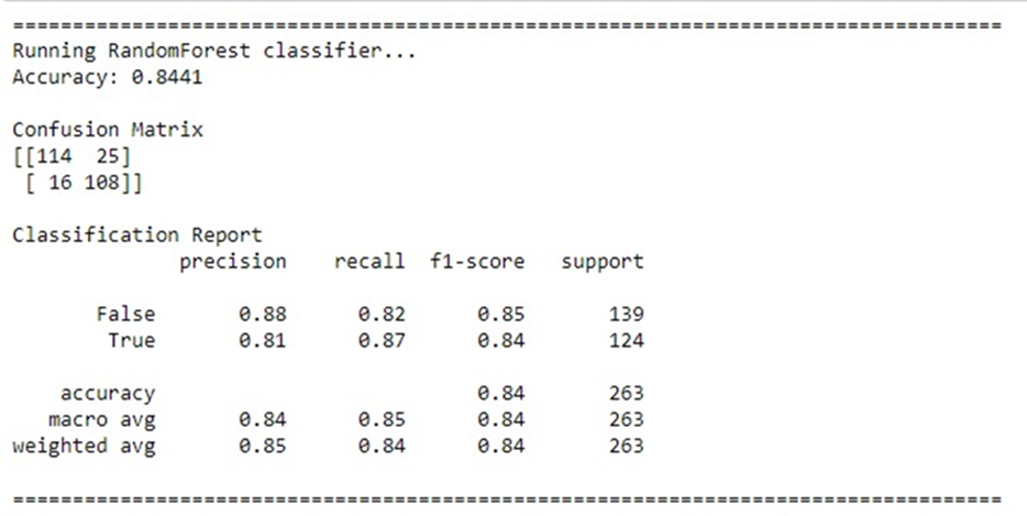
Validation
Obtained Accuracy : 84%
Confusion Matrix
Accuracy Result of Dataset

Slide 20
ML to C-Code Implementation
Libraries used:
Training Model :
NumPy
Sklearn
ML to C-code:
MicroML gen
NN
Model
Training
Model
C-code
Input
MicroML
Library
Output
Jupyter
Arduino IDE
Arduino
UNO

Slide 21
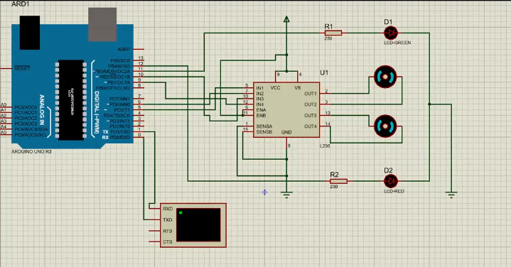
Hardware Working Diagram

Slide 22
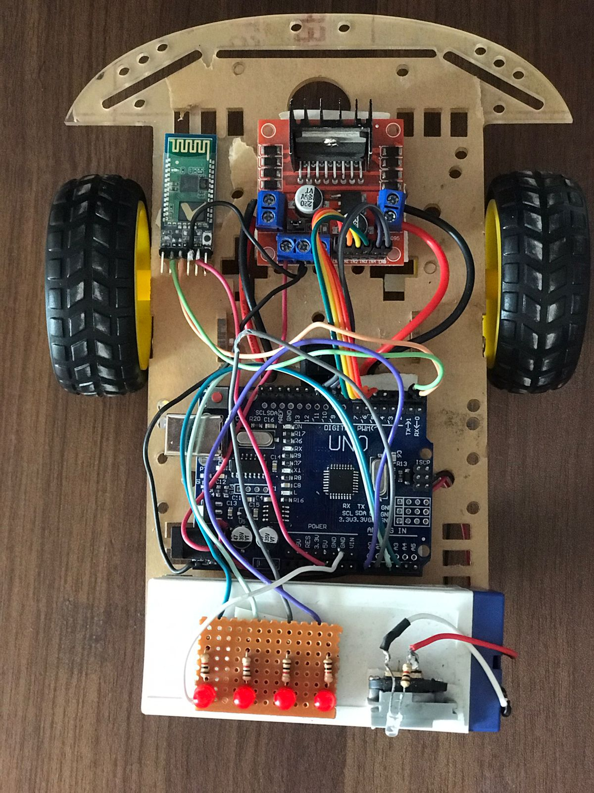
Project Hardware
Brainlink mindwave EEG Headset:
WheelChair Prototype:

Slide 23
Hardware Components:
Brainlink mindwave EEG Headset
Arduino UNO
16V Battery
L298 Motor Driver
DC Motor x 2
HC-06 Bluetooth Module x 2

Slide 24
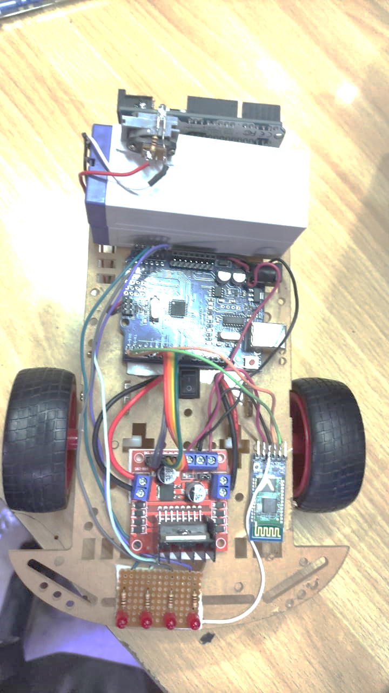
Results
Brain Controlled Wheelchair prototype based on Artificial Intelligence is designed .
Wheelchair model move around using brain waves based on Jaw movements acquired by EEG headset.
Wheelchair Prototype moves right, left , backward, forward and rest as we clench our jaw right, left, fully clench, loosen clench and then no clench respectively.

Slide 25
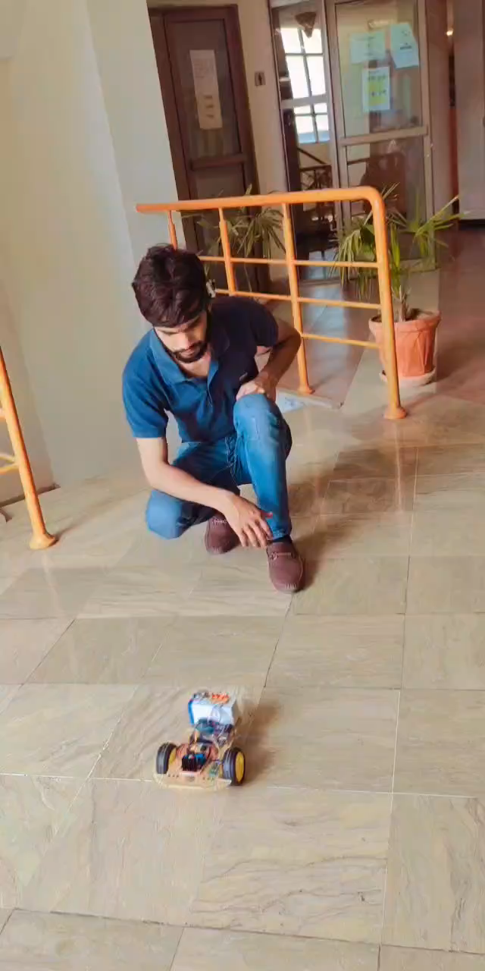
Project Working Video

Slide 26
Summary
Project works on Jaw movements in form brainwaves.
These brain waves acquired through EEG headset in form of signals.
Signals are processed in Jupyter Notebook to give output in form of alpha waves.
Trained ANN model using different datasets which further performs motor functions.
Trained data is burnt on Arduino to drive wheelchair using C code.
Thus, wheelchair model moves to provide assistance to LIS Patients
An AI(Artificial Intelligence) based Brain Controlled Wheel Chair prototype is our final product.

Slide 27
Limitations
Interfacing of EEG Headset with PC
Loading ANN Model on Arduino Uno
Corruption of large data in Serial Communication
Selection of EEG Headset
Large noise detection in motion signals
Desired EEG Headset was expensive
An abundance of time was consumed in import of EEG Headset

Slide 28
Future Work
Implementation using more advanced Artificial Intelligence Models.
More Machine Learning algorithms can be implemented with convergent of Random Forest.
More features can be added like location tracking and heartbeat tracking.
More Accuracy can be achieved.
More sensitivity can be maintained.
This work with more amendments can be introduced in to market.

Slide 29
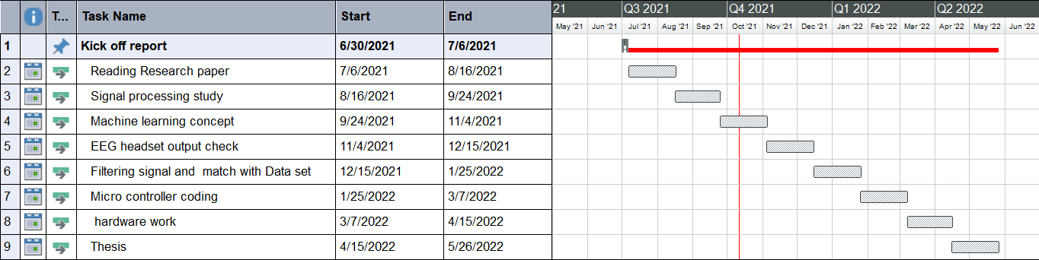
Project Timeline

Slide 30
Bibliography
[1] https://www.ncbi.nlm.nih.gov/pmc/articles/PMC549115/
[2] https://dphhs.mt.gov/schoolhealth/chronichealth/neurologicaldisorders.
[3] A case study of Locked-In-Syndrome: Psychologicaland personal perspectives .[online].Available at: https://www.researchgate.net/publication/50986080_A_case_study_of_Locked-In-Syndrome_Psychological
[4] https://www.theguardian.com/uk/2012/aug/22/tony-nicklinson-right-to-die-case
[5] Mohammad Monirujjaman Khan1,* , Shamsun Nahar Safa1 , Minhazul Hoque Ashik 1 , Mehedi Masud2 and Mohammed A. AlZain"Research and Development of a Brain-Controlled Wheelchair for Paralyzed Patients "vol. 123, no. 12, pp. 50–54, 2015.
[5] Arjon Turnip, Member, IEEE, Demi Soetraprawata, Mardi Turnip, Endra Joelianto, Member, IEEE. Vol.8/No.1 (2016) INTERNETWORKING INDONESIA JOURNAL 65 ISSN: 1942-9703 / © 2016 IIJ EEG-Based Brain-Controlled Wheelchair with Four Different Stimuli Frequencies
[7] International Review on Modelling and Simulations (I.RE.MO.S.), Vol. 14, N. 1 ISSN 1974-9821 February 2021 Copyright © 2021 Praise Worthy Prize S.r.l. - All rights reserved https://doi.org/10.15866/iremos.v14i1.17842 18 Mind-Wave Wheelchair System M0azen Abuzaher, Jamil Al-Azzeh.
[8] https://www.researchgate.net/figure/Brain-Waves-Frequencies_fig1_254256161
[9] https://www.electrical4u.com/butterworth-filter/
[10] https://www.electrical4u.com/band-stop-notch-filter/
[11]NeuroTechX-McGill-2019/offline/data/March 4/11_NoJaw_Rest_Left_Right_5secs
[12] https://github.com/NTX-McGill/NeuroTechX-McGill-2019/

Slide 31
ANY QUESTIONS?

Slide 32
THANK YOU.

Slide 33
More Information (1/2)

Slide 34
More Information (2/2)

